Slide 1

ONLINE
CAR
AGENCY

Slide 2
Team Members
Rishabh Agarwal
201500563
Ashish Sengar
201500165
Rohit Saxena
201500590
Ayush Kumar
201500180

Slide 3
Abstract
Introduction
Content
Project Design
Project Analysis
Alternative Solution Analysis
Project Progress Evaluation
Future Scope

Slide 4
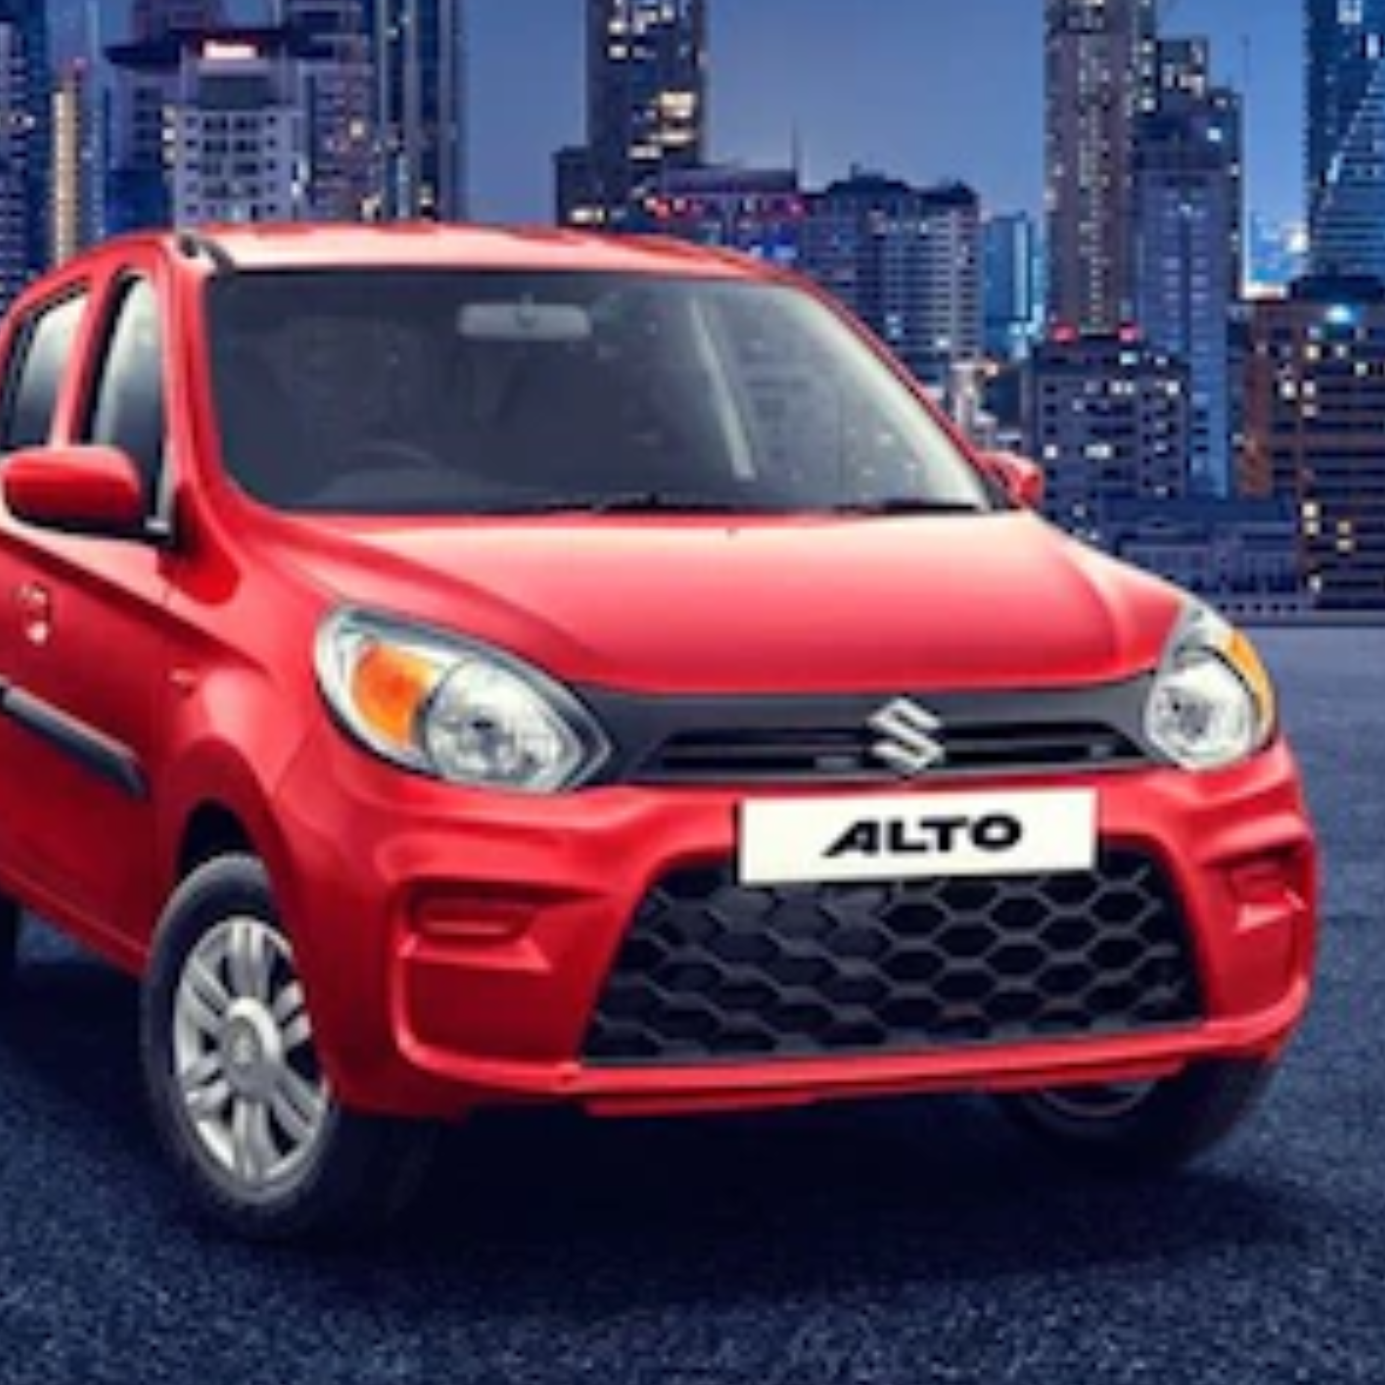

Abstract
The Quick Auto Lease is a web-based application that allow
visitors to know about Maruti Cars.
This system is established for all the users , those who are having interest in buying or selling car.

Slide 5
Introduction
Our web application is for car agency. Every car agency has some data in itself and every car agency want to share some data with customers like latest car of this year, most searched car, and features of car. And about your agency.
In this project any customer want to buy a new car with a specific company then he can visit this website and find the car with it’s price and features.

Slide 6
Project Analysis
Objective:
Advertise our Maruti Car Agency and Tell about the Maruti cars features to the users.
Problem:
Customers come direct to the showroom and wait in waiting list for appointment and for collect cars details. For overcome this problem we make this web application.
Solution:
Grab the details of cars and book appointment for buy new or sell old car.

Slide 7
OBJECTIVES
The main objectives of the quick auto lease include:
To provide a web-based car agency. Customer can book the appointment and no need to queue up to buy but car at the showroom.
If customer sell old car he/she will fill the Prize of old car and get the approx prize of car , after this we allot token no.
To ease the car booking . Customer has to fill partial details and book appointment for showroom visit.

Slide 8


Analyzing the cost of the solution
Cost : No Cost the project is hosted on Github.
Time to Develop : 40 hours

Slide 9
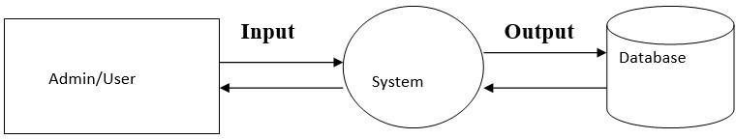
Data Flow Diagram of the Site -
Level 0:
Buy new
Book Appointment
Buy old
Sell Old
Predict Old car Prize
Services
Book Service Appointment

Slide 10
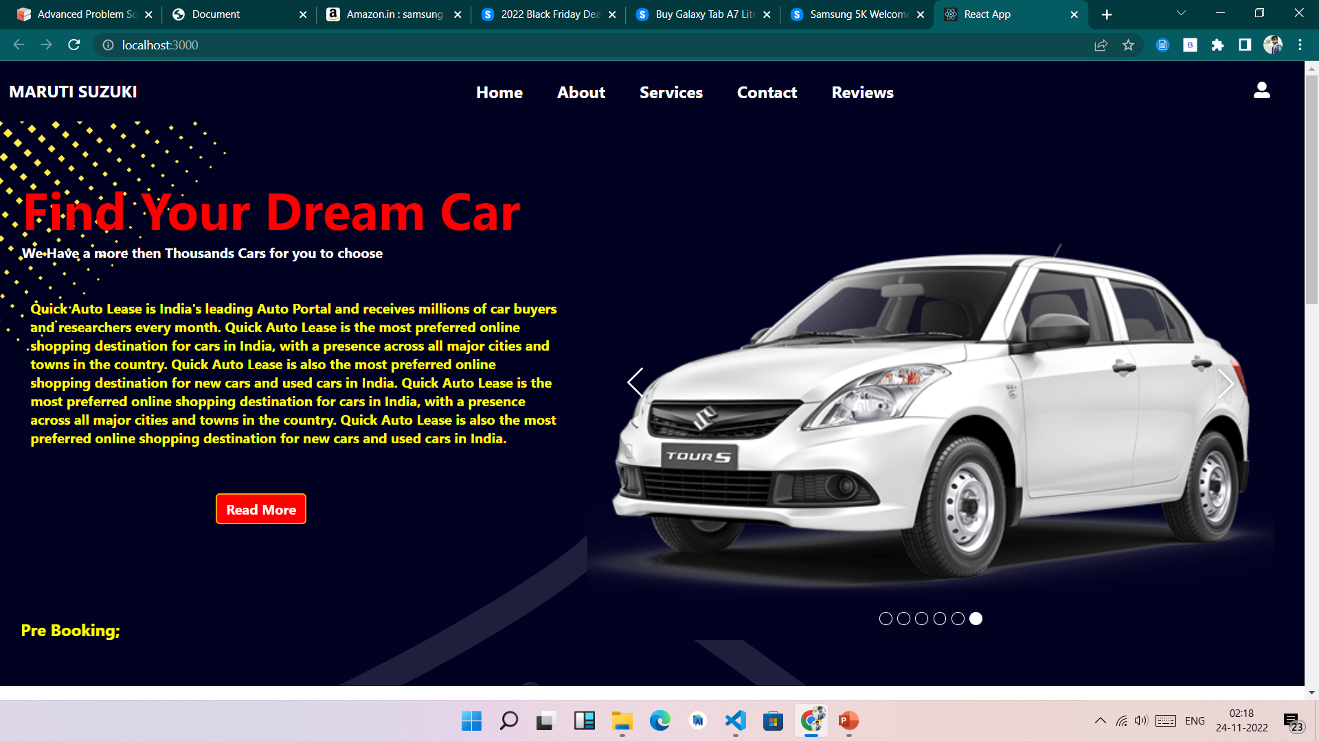
Home Page:

Slide 11
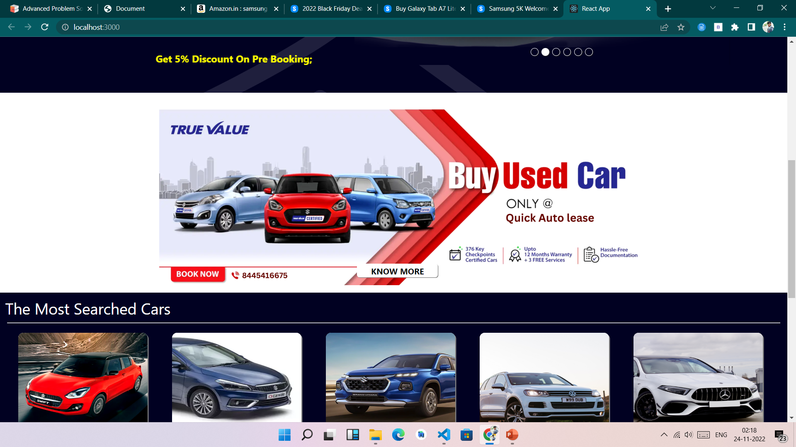
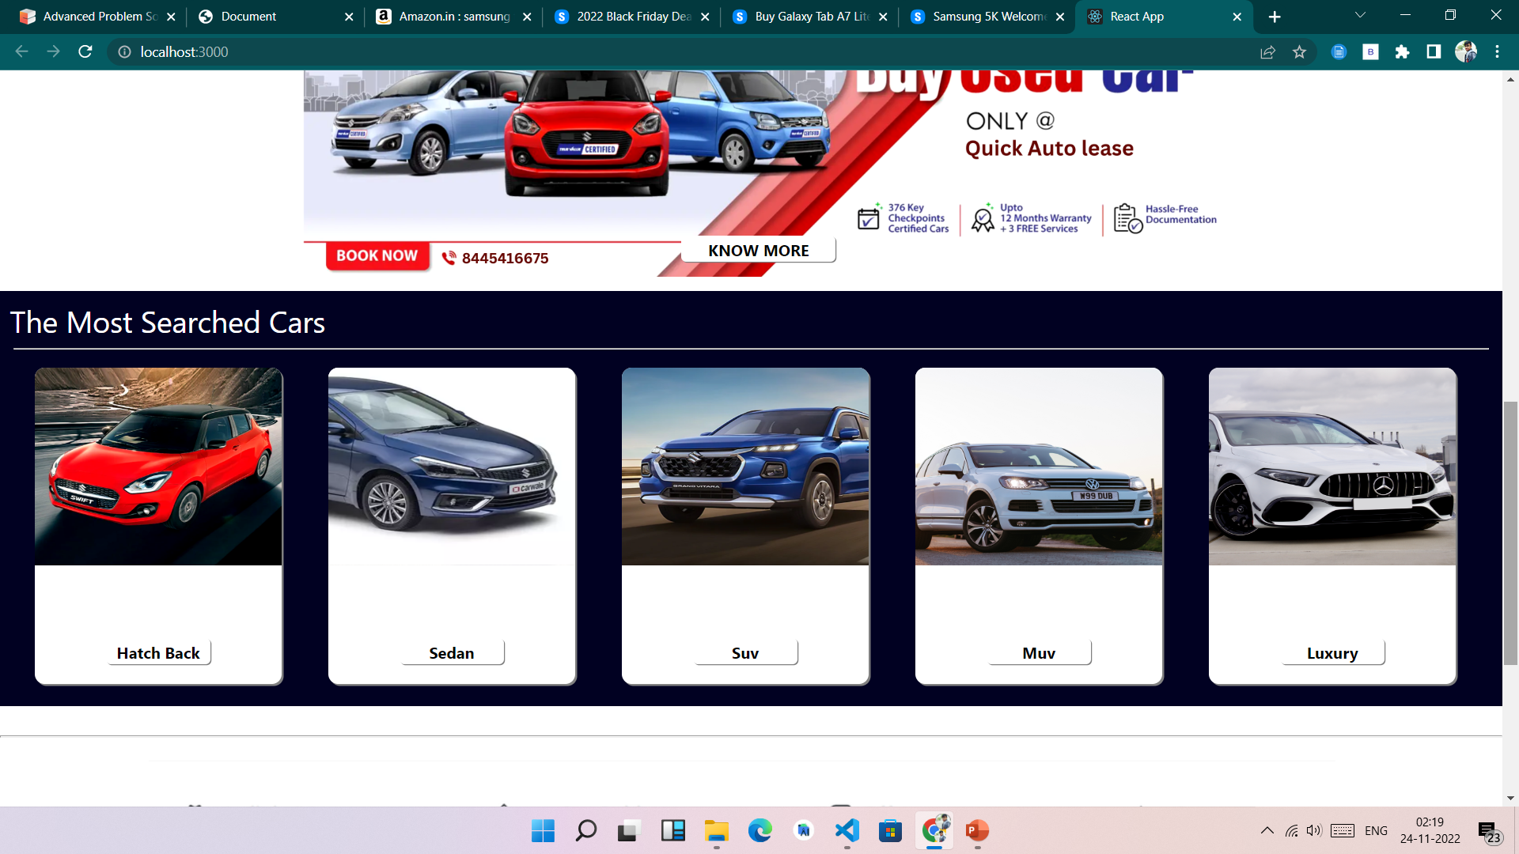

Slide 12
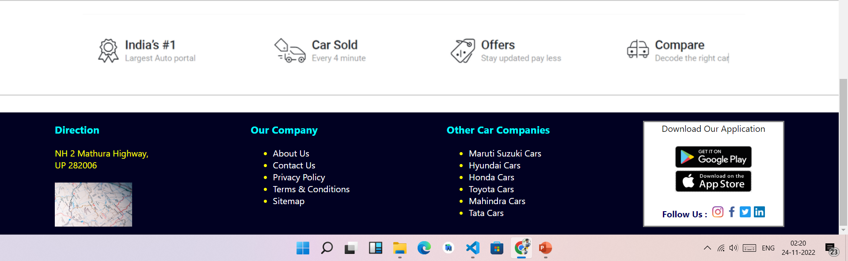

Slide 13
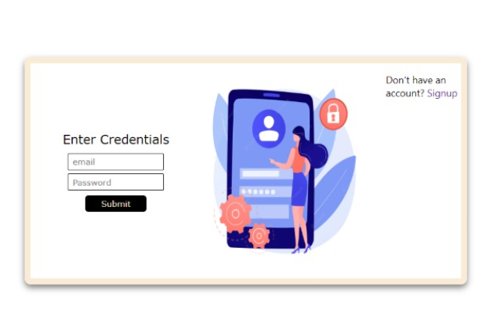
Login page
Login Page consist of username and password.
Customer have to give username and password to login.
System validates the details.

Slide 14
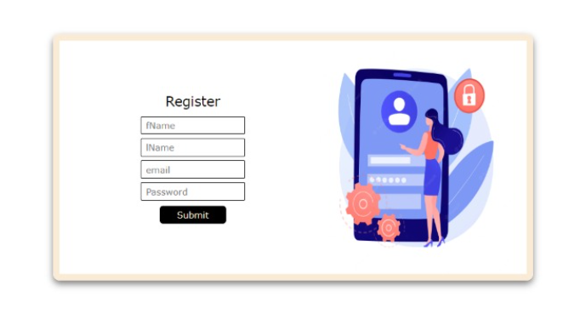
SignUp page

Slide 15
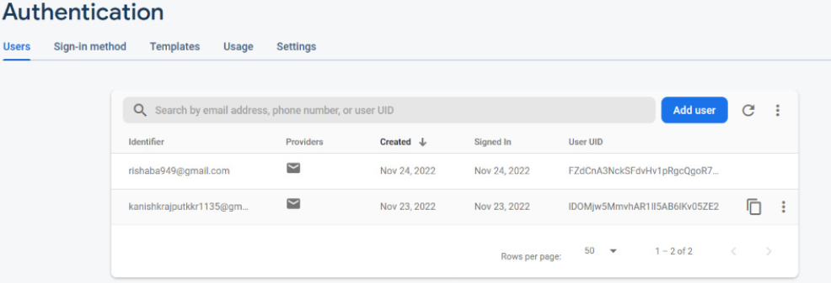
Firebase Database

Slide 16
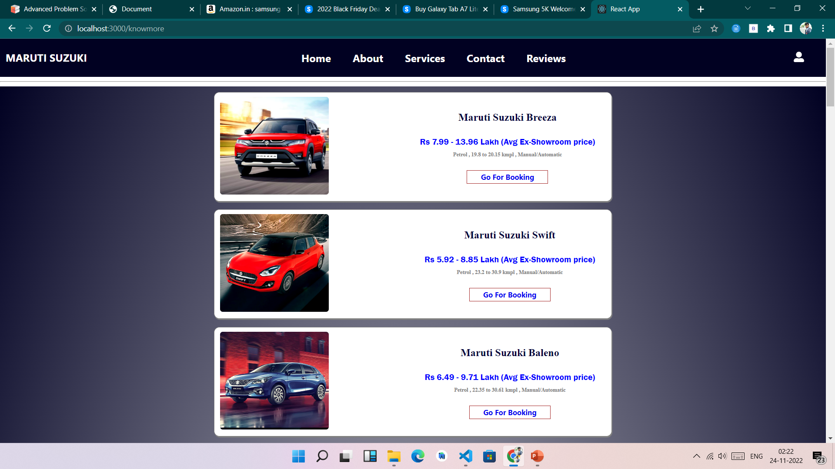
Car Details Section :

Slide 17
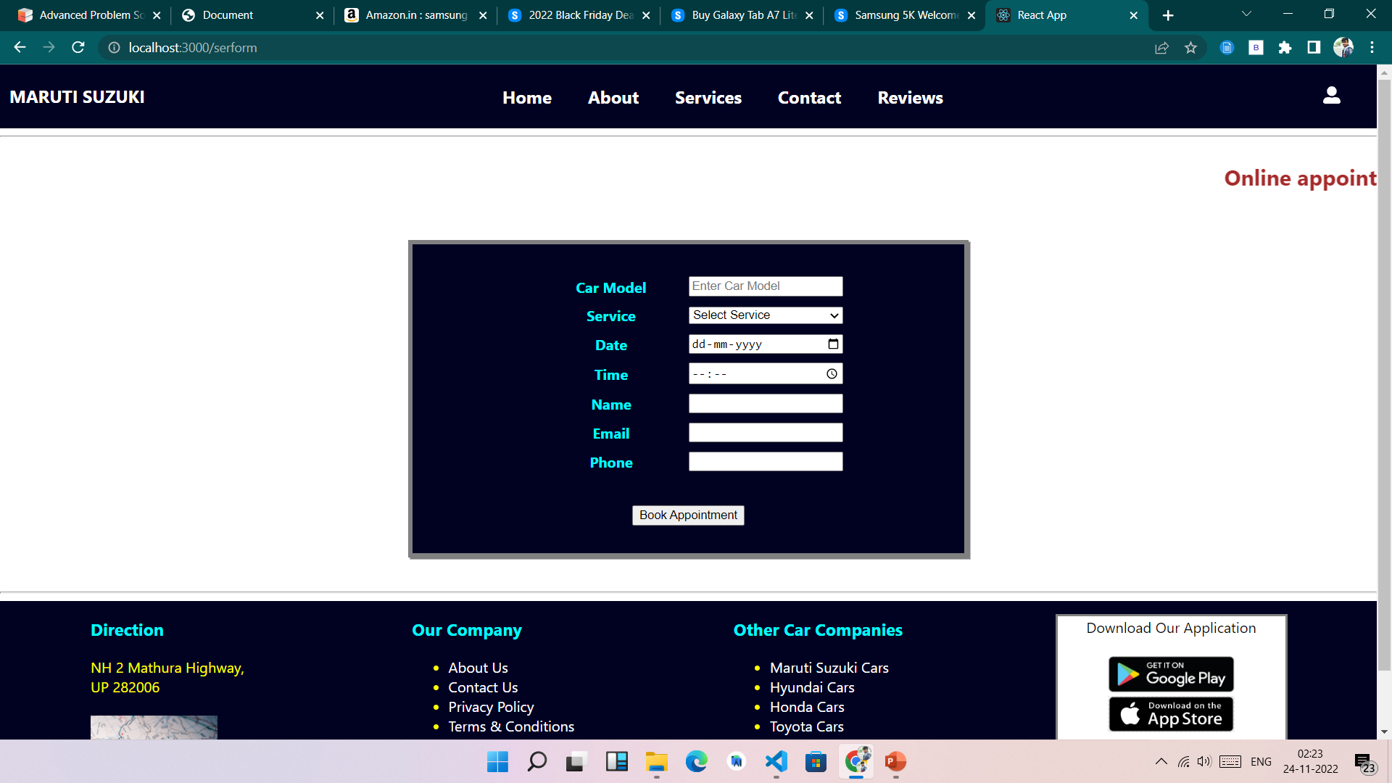
Check Old Car Prize Prediction

Slide 18
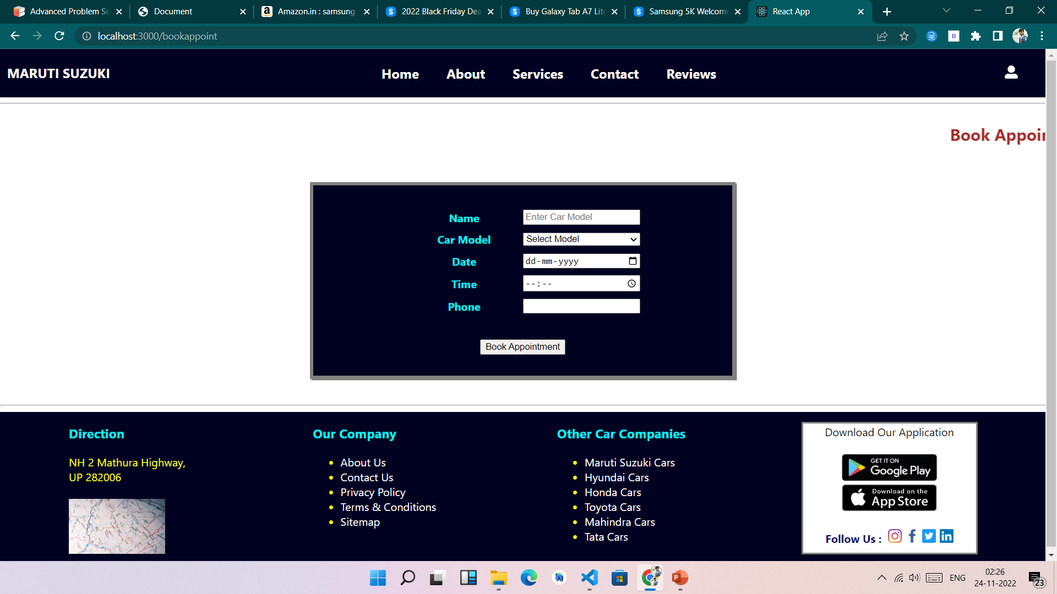
Online Appointment Booking:

Slide 19
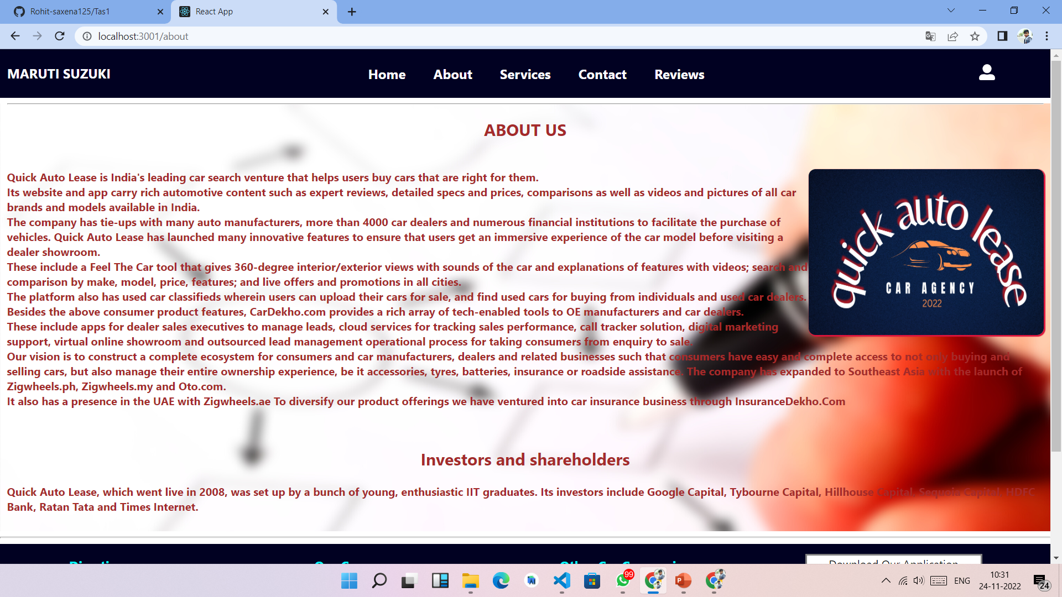
About Section

Slide 20
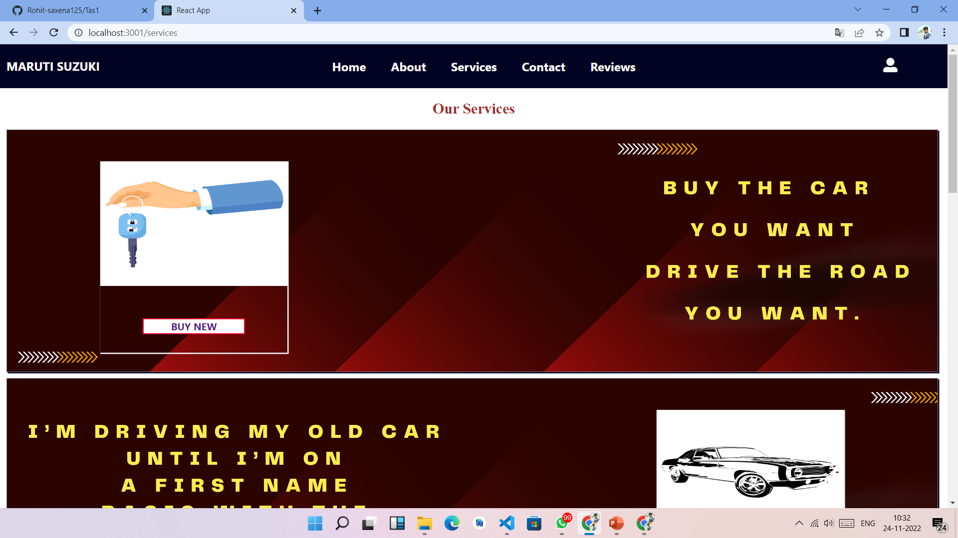
Services

Slide 21
Programming Languages / Technologies Used
Html5 : Html stands for Hypertext Mark-up Language . It used for mainly to display text code as well as formatting these texts.
CSS : CSS stand for Cascading Style sheets. This is a very powerful language for formatting the web pages and has been of great help in my project.
Java scripts : Java scripts played a very crucial role in adding some functionalities to my system . These included sliding images, a features which is much clear in the system’s homepage.
React : It is JavaScript library used for building reusable UI components.
Firebase : It is a Backend-as-a-Service (Baas). It provides developers with a variety of tools and services to help them develop quality apps, grow their user base, and earn profit.
Node Js : Node.js is a server-side platform built on Google Chrome's JavaScript Engine (V8 Engine).
ML : Machine learning is subfield of computer science with the goal of exploring, studying, and developing learning systems, methods, and algorithms that can improve their performance with learning from data.
Flask : Flask is used for developing web – applications using python.

Slide 22
Additional Future Plans
Old Car Section for Buy
OTP othentication
Notification system
Chat functionality
Coupon management

Slide 23
Conclusion
It can be observed that computer application are very important in every field of human endevaour . Here all the information about customer get prize of car can be gotten just by clicking system are overcome.
It will also reduce the workload of the staff, reduce the time used for booking of car at the Showroom and increase efficiency.

Slide 24
Thank You

